Slide 1

Learning Partners Academy Trust Safeguarding Training
September 2025

Slide 2



Objectives of today’s training…
The importance of safeguarding, and why it should be everyone’s focus
Legislation and guidance updates
Types of abuse, neglect and what to look out for
Specific safeguarding issues locally and nationally
Action to take if you have a concern
Please look after yourself and others during this training – some topics are sensitive in nature

Slide 3
Safeguarding and child protection
Safeguarding is… the action you take to promote the welfare of children and protect them from harm.
Child protection is… part of the safeguarding process. It focuses on protecting individual children identified as suffering, or likely to suffer, significant harm. This includes child protection procedures detailing how to respond to concerns about a child.
(NSPCC, 2025)
It’s important to remember that the Data Protection Act and UK GDPR do not prevent the sharing of information for the purposes of keeping children safe and promoting their welfare.
With regards to safeguarding, school staff are particularly important, as they are in a position to identify concerns early, provide help for children, promote children’s welfare and prevent concerns from escalating.
(KCSIE, 2024)

Slide 4
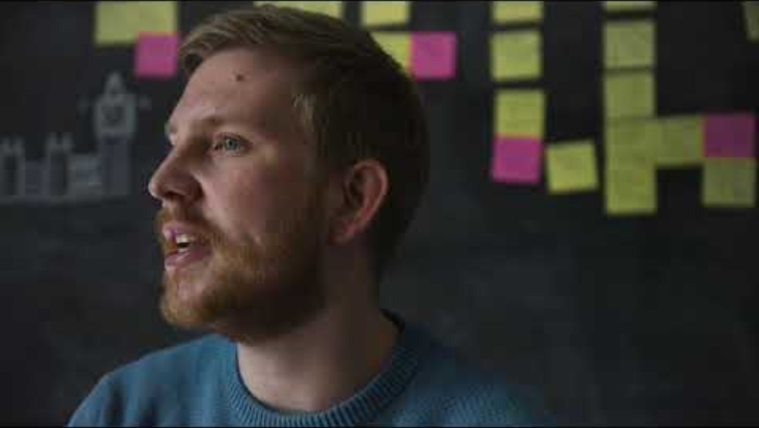
What is safeguarding to you? Views of different professionals
Please keep in mind that safeguarding is everybody’s responsibility
Do you have any views that differ to those of the people within this video?

Slide 5

Legislation
Commonly used guidance within schools:
Keeping Children Safe in Education 2025
Working Together to Safeguard Children 2023
Other relevant guidance includes:
What to do if you’re worried a child is being abused: advice for practitioners 2015
Education Act 2022
Children Act 2004
UN Convention on the Rights of the Child
All staff should be aware of systems within school which support safeguarding. This should include the:
Safeguarding and child protection policy
Behaviour policy
Staff code of conduct
Safeguarding response to children who are absent from education
Role of the designated safeguarding lead

Slide 6

Recent changes in legislation
Updates to KCSIE 2025 are about refining and strengthening what is already within the guidance, rather than any significant changes.
Changes include…
Clarification that the DfE's Working Together To Improve School Attendance is now statutory guidance
Changes to the list of content risks under online safety, adding in disinformation, misinformation and conspiracy theories – these are now explicitly recognised as safeguarding harms
More information on the DfE guidance on generative artificial intelligence (AI)
Additional information on, and clarity around, alternative provision guidance – safeguarding oversight does not end when a child is offsite
Clarity on Virtual School Heads and their non-statutory responsibilities around children in kinship care
The guidance also mentions forthcoming revised guidance on gender questioning children and relationships, sex and health education, both expected this summer.

Slide 7




Types of abuse and neglect
Neglect
Neglect is… the persistent failure to meet a child’s basic physical and/or psychological needs, likely to result in the serious impairment of the child’s health or development. This includes failing to provide adequate food, clothing, shelter, supervision, or medical care (KCSIE, 2024)
What signs should we be looking out for?
Frequent hunger
Poor personal hygiene
Frequent tiredness
Inadequate and/or dirty, ill-fitting clothing
Being under or overweight
Social isolation
Poor self-esteem
Frequent lateness or missing education
Missed medical /dental appointments
Poor relationships with peers
Stealing from others

Slide 8
Types of abuse and neglect
Physical abuse
Physical abuse is… deliberately causing physical harm to a child, which can include actions like hitting, shaking, throwing, or poisoning, or causing harm through scalding, drowning, suffocating, or deliberately inducing illness. It can also involve causing physical harm by fabricating symptoms of illness in a child (KCSIE, 2024)
Signs of physical abuse can include…
Bruising, particularly in more unexpected places on the body such as the face, neck and ears
Burns
Bite marks
Broken bones
Fear of specific individuals
Unusual covering of body parts
Withdrawn behaviour
Aggressive behaviour

Slide 9
Take a look at the following scenario
Oliver has been absent from school for a week due to breaking his leg at the weekend when
with his father. He has returned to school on a restricted timetable, and he must not take part
in physical activity whilst his leg is in plaster.
During the class PE lesson, Oliver likes to read in a quiet room. When you ask how he broke
his leg, he tells you he was playing football.
He then becomes upset and when you ask why he’s crying, he says, ‘We were having a day
out with dad, and he got angry when I let the ball go into the river. He pushed me over and
stamped on my leg. He told me to say I fell over.’
How would you handle this concern? What would you say to Oliver? What steps would you take when reporting this?

Slide 10
Types of abuse and neglect
Sexual abuse
Sexual abuse… involves forcing or enticing a child or young person to take part in sexual activities, not necessarily involving violence, whether or not the child is aware of what is happening.
The activities may involve physical contact or non-contact activities, such as involving children in looking at, or in the production of, sexual images, watching sexual activities, encouraging children to behave in sexually inappropriate ways, or grooming a child in preparation for abuse (KCSIE, 2024)
Signs of sexual abuse can include:
Language or sexual behaviour you wouldn't expect them to know
Fear of specific people
Nightmares or bed wetting
Self harm
Changes in eating habits
Not wanting to go home
Being irritable, distant, upset or angry
Being secretive
Bleeding, discharge, pain or soreness in their genital area
Sexually transmitted infections
Pregnancy
Difficulty walking or sitting

Slide 11
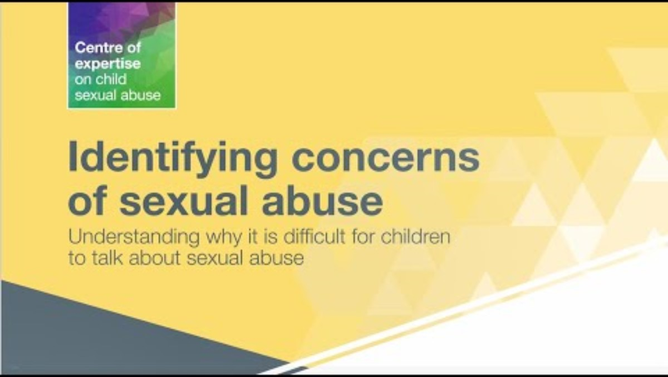
Types of abuse and neglect
For more videos within this series, please see:
www.csacentre.org.uk

Slide 12
Types of abuse and neglect
Emotional abuse
Emotional abuse is… the persistent emotional maltreatment of a child such as
to cause severe and adverse effects on the child’s emotional development. It may
involve:
Conveying to a child that they are worthless or unloved, inadequate, or
valued only insofar as they meet the needs of another person
Not giving the child opportunities to express their views, deliberately silencing them or ‘making fun’ of what they say or how they communicate
Age or developmentally inappropriate expectations being imposed on children
Seeing or hearing the ill-treatment of another
Serious bullying (including cyberbullying), or the exploitation or corruption of children
Some level of emotional abuse is involved in all types of maltreatment of a child, although it may occur alone
(KCSIE, 2024)

Slide 13


Types of abuse and neglect
Emotional abuse
Signs to look out for:
Difficulty making or maintaining relationships
Struggling to control emotions
Low self-esteem
Being overly affectionate to strangers or people they don’t know well
Seeming unconfident, wary or anxious
Distant relationship or lack of bond with their parent/carer
Lacking in social skills
Having few or no friends

Slide 14



Other safeguarding issues to be aware of
Safeguarding encompasses many different areas other than those we’ve just discussed.
Other risks to children and young people include:
Child on child abuse
Child sexual exploitation
Child criminal exploitation
Domestic abuse
Female genital mutilation
Mental health
Serious violence
Violence against women and girls
Which of the above do you see within your school?
For more information on any of these topics, please contact your schools safeguarding team.

Slide 15
Female Genital Mutilation duty
Whilst all staff should speak to the designated safeguarding lead (or a deputy) with regard to any concerns about female genital mutilation (FGM), there is a specific legal duty on teachers. If a teacher discovers that an act of FGM appears to have been carried out on a girl under the age of 18, the teacher must report this to the police.
(KCSIE, 2024)
For known cases of female genital mutilation:
Call 101 to report this, or 999 if you feel the child or young person is in immediate danger
Ensure you make your schools DSL aware as soon as possible, and make a record of the incident and actions taken

Slide 16
Prevent duty
All schools are subject to a duty under section 26 of the Counter-Terrorism and Security Act 2015, to have “due regard to the need to prevent people from becoming terrorists or supporting terrorism”. This duty is known as the Prevent duty.
All staff have a role to play. It’s important to:
Look out for signs that a child is susceptible to an extremist ideology or being drawn into terrorism​
Report what you’ve seen​ to your DSL
Challenge extremist ideas

Slide 17



Online safety
Online safety is an umbrella term for promoting the safeguarding of children and young people when using any device over the internet.
The number of online issues that could be regarded as harmful is considerable, but they can be categorised into four areas of risk:
Content: exposure to illegal, inappropriate or harmful materials. For example, pornography, fake news, racism, misogyny, self-harm, eating disorders, suicide, radicalisation and extremism
Contact: being subjected to harmful online interactions with other users. For example, peer pressure, cyberbullying, adults posing as children with the intention to groom or exploit them for sexual, criminal, financial or other purposes
Conduct: personal online behaviour that increases the likelihood of or causes harm. For example, making, sending and receiving consensual and non-consensual nudes, sending sexually explicit messages, cyberbullying, obsessive use of the internet, stalking, and harassment
Commerce: finance-based risks. For example, online gambling, in-game spending, inappropriate advertising, and financial exploitation
19% of children, aged 10-15-years-old, exchanged messages with someone online who they had never met before in the last year
Over 9,000 child sexual abuse offences involved an online element in 2022/23
Around a sixth of people that experienced online harassment offences were under 18-years-old
(NSPCC, 2024)

Slide 18
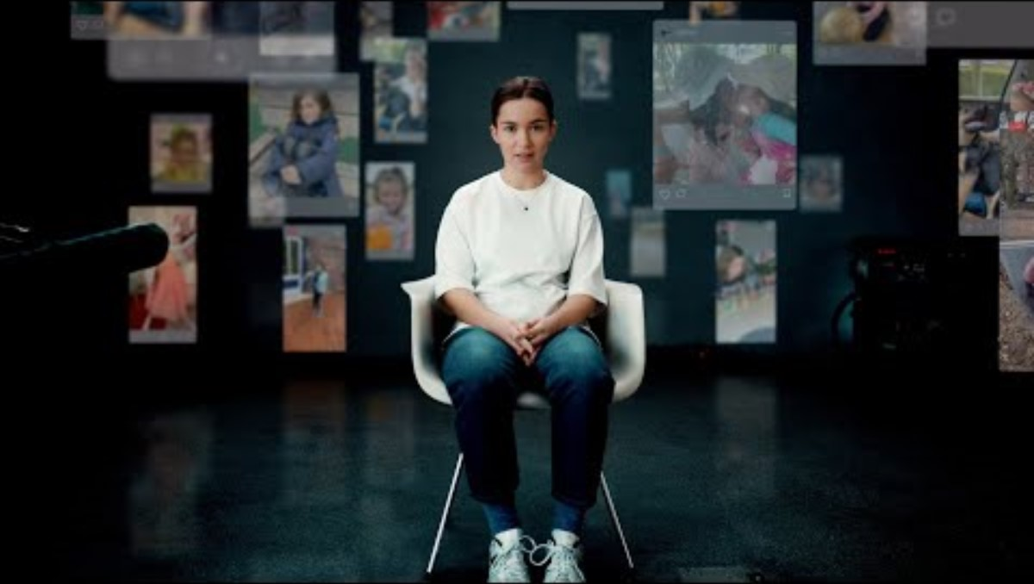
Online safety
As well as teaching children how to stay safe online, educating parents and carers on the dangers of internet use is also paramount.
Is there anything in this video that surprised you? Do you think children and parents/carers within your school are knowledgeable about online safety?

Slide 19


Vulnerable children
All children are vulnerable to harm and abuse; however, some children have additional vulnerabilities and schools play a key part in supporting these children. Some of these additional vulnerabilities to be mindful of are:
Early Years
SEND
Children with disabilities
Domestic abuse present at home
Mental health difficulties (themselves or family members)
Substance abuse (themselves or family members)
Homelessness
Black, Asian and minoritised ethnic communities
LGBTQ+
Children in care
Children with a parent in prison
Living in poverty

Slide 20
It can and does happen here
Number of safeguarding-related incidents recorded by staff last academic year ……..
Number of referrals made to Children’s Services ……..
Number of children currently receiving support via Early Help, Child in Need or Child Protection plans ……..
Our most common safeguarding issues within school are ………
Around…​
1 in 20 children in the UK have been sexually abused​​
1 in 15 children in the UK have been emotionally abused
1 in14 children in the UK have been physically abused
1 in10 children in the UK have experienced neglect
3 in 10 children in the UK are living in poverty (poverty is not the same as neglect, but it does increase the risk of experiencing neglect)
(NSPCC, 2024) (Action for children, 2024)
The current priorities in relation to safeguarding children in Surrey are neglect, early help and child and adolescent mental health and emotional well-being (Surrey Safeguarding Children Partnership annual report, 2023-2024)

Slide 21
Our safeguarding team
Designated Safeguarding Lead Deputy Designated Safeguarding Leads
(insert photo, name and (insert photos, names and contact details)
contact details)

Slide 22




Safeguarding at Learning Partners Academy Trust
Holly Wise, Trust Safeguarding and Mental Health Lead
hwise@learningpartners.org
Olivia Wernick, Trust Inclusion Lead
owernick@learningpartners.org
Renata Joseph, Safeguarding Trustee
rjosephtrustee@learningpartners.org
Jack Mayhew, Trust CEO
jmayhew@learningpartners.org

Slide 23

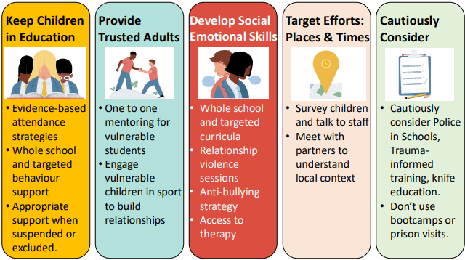
5 Principles For Safeguarding and Inclusion
Evidence shows that these 5 principles have high success rates with regards to safeguarding and inclusion, and particularly in the reduction of violence.
It’s a good reminder of the importance of using evidence-based strategies in our work with children.
Some strategies, such as police visits to schools, have little evidence of effectiveness.
(Confederation of School Trusts, 2025)

Slide 24


Dealing with a disclosure
Children and young people may disclose abuse in a variety of ways, including:
Directly – making specific verbal statements about what’s happened to them
Indirectly – making ambiguous verbal statements which suggest something is wrong
Behaviourally – displaying behaviour that signals something is wrong (this may or may not be deliberate)
Non-verbally – writing letters, drawing pictures or trying to communicate in other ways.
How to respond to disclosures:
Show you care, help them open up - Give your full attention to the child and keep body language open and encouraging. Be compassionate, understanding and reassure them their feelings are important
Take your time, slow down - Respect pauses and don’t interrupt the child – let them go at their own pace. Remember that it may take several conversations for them to share what’s happened to them
Show you understand, reflect back - Make it clear you’re interested in what the child is telling you. Reflect back what they’ve said to check your understanding – and use their language to show it’s their experience
Don’t promise that you won’t tell anybody else what they’ve disclosed – this isn’t a promise you’re able to keep
(NSPCC, 2025)

Slide 25
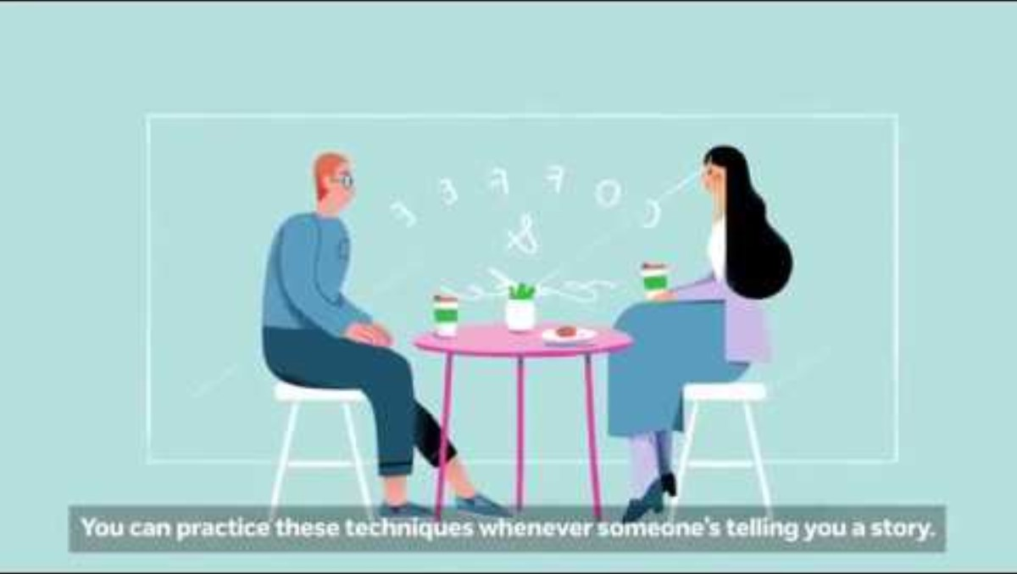
Dealing with a disclosure

Slide 26


Recording concerns
Safeguarding related incidents must always be recorded on CPOMS. More serious incidents should also be reported to the DSL as soon as possible.
Be mindful that incidents may seem minor or of little significance, but could be part of a much larger picture – if in doubt, log the incident regardless
Record the incident as soon as possible. Safeguarding should always take priority
Any paper records relating to the incident, for example a child’s drawing or writing, should be uploaded on to CPOMS and then securely stored by the DSL
Keep language factual, and not emotive
Give reasoning behind any actions undertaken
Ensure the recording is as clear and concise as possible
Ensure grammar and spelling is accurate – incident recordings may be passed on to other agencies or occasionally used within a court case

Slide 27
Recording concerns
Take a look at the following recording of an incident:
I couldn’t get Alice to do anything today and she kept putting her head on the table. She barely touched her lunch. She’s shouted at a few other children recently. I’m so worried something might be happening at home. I called her parents for a chat about her, but no one answered.
What changes would you make to this recording if you were writing it yourself?
Should you need support with CPOMS, there are various ways to access this:
On your ‘Dashboard’ home page, click on ‘Support’ (bottom left-hand corner of the page). There are various helpful resources to view, and a support team contact option
Speak to your DSL or a DDSL
Contact the Learning Partners Trust Safeguarding Lead, Holly Wise - hwise@learningpartners.org

Slide 28
Low level concerns
A low-level concern is any concern – no matter how small, and even if no more than causing a
sense of unease or a ‘nagging doubt’ - that an adult working in or on behalf of a
school may have acted in a way that is inconsistent with the staff code of conduct. This includes inappropriate conduct outside of work.
Examples of such behaviour could include, but are not limited to:
Being over friendly with children
Having favourites
Taking photographs of children on their mobile phone
Engaging with a child on a one-to-one basis in a secluded area or behind a
closed door
Humiliating children
KCSIE, 2024

Slide 29
Low level concerns
Take a look at the following scenario…
You are passing a classroom and glance in. You witness a teacher tightly gripping Ryan’s
upper arms shouting into Ryan’s face that ‘it won’t be long before you join your father in
prison, you good for nothing little…’ whilst the rest of the class look on. Ryan looks scared.
Some of the students have their mobile phones out.
Which aspects of this incident concern you? What action would you take?

Slide 30
Reporting concerns
If you have concerns about…​ | Speak to…​
A child or young person | The DSL
A member of staff in a school​ | The Headteacher​
A volunteer​ | The Headteacher​
The Headteacher​ | Chair of Governors​
A member of the Central Team​ | The CEO, Jack Mayhew​
The CEO​ | The Chair of Trustees, Andrew Isherwood ​
Useful contacts:
Surrey Children’s Services
0300 470 9100
cspa@surreycc.gov.uk
NSPCC
0808 800 5000
help@nspcc.org.uk
Police
999 in case of emergencies
101
Crimestoppers
0800 555 111
www.crimestoppers-uk.org

Slide 31
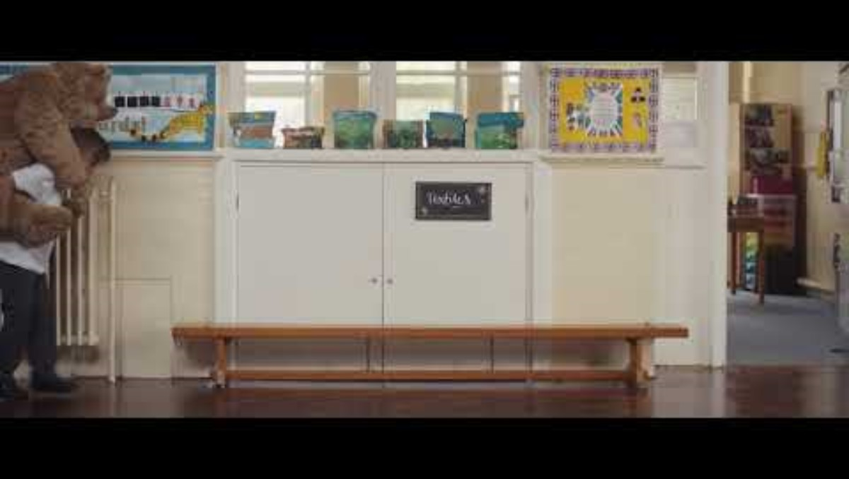
A reminder that we sometimes do not know what a child is facing outside of school
Small actions and kindness towards children and young people in your school can make a huge difference.
Thank you for all you do to help keep children safe.

